Slide 1
Bombay Blood Group
Rare Blood group
Can donate blood to all in ABO system
Can’t receive blood from any

Slide 2
Biochemistry of A, B, H Antigens
ABO antigens are located on RBCs, lymphs, platelets, tissue cells, bone marrow and solid organs.
Antigens ARE NOT direct products of the genes.
Genes code for TRANSFERASE which causes transfer of monosaccharide molecule onto a precursor substance on the RBC.

Slide 3
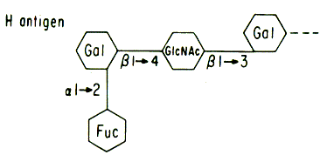
H Gene (Chromosome 19)
Codes for the production of fucosyl transferase that catalyzes the addition of L-fucose,the immunodominant structure of H antigen
The H gene and its allele h are inherited independently of the allelic A, B and O genes
H antigen only person is group O.
Once L-fucose added A and B gene specified products can be add their sugars.

Slide 4
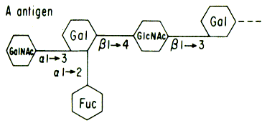
A Gene
Codes for production of a galactosaminyl transferase that effects the addition of N-acetyl-galactosamine to the preformed H-bearing chains.

Slide 5
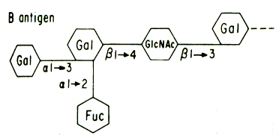
B Gene
Codes for production of a galactosyl transferase that effects the addition of D-galactose to the same H-bearing structure.

Slide 6
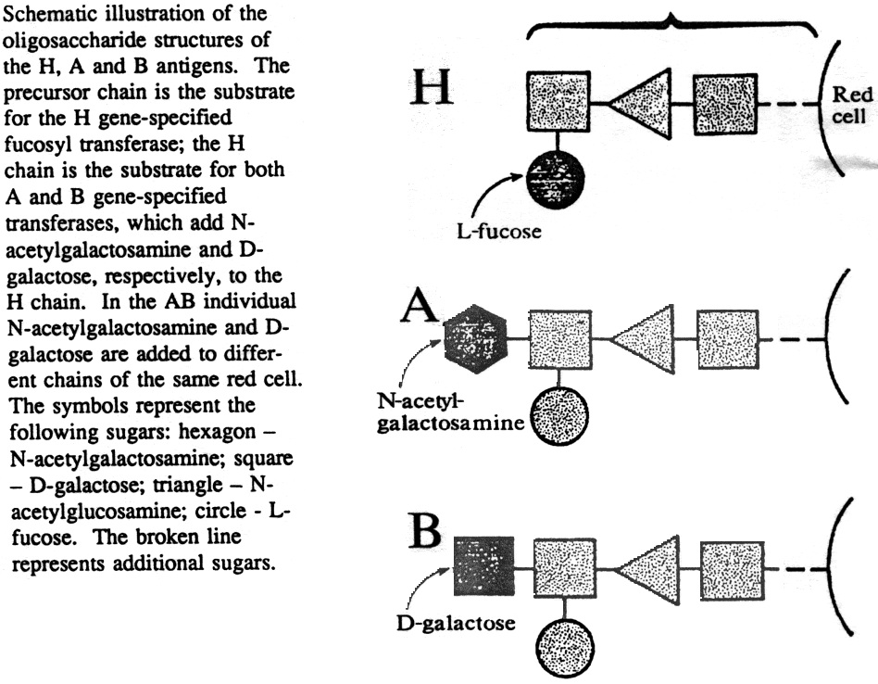

Slide 7
Monohybrid vs Dihybrid Cross
A monohybrid cross is one where only one trait is crossed.
e.g. A tall pea plant TT is crosses with a short pea plant tt.
A dihybrid cross is one where two traits are crossed.
e.g. a tall, purple flowered plant TtGg is crossed with a short, white flowered plant ttgg.

Slide 8
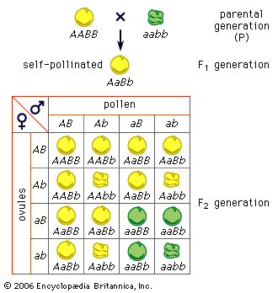
Law of Independent Assortment
The Punnett square is a diagram that is used to predict an outcome of a particular cross or breeding experiment
F2 Ratio- 9 (round, yellow):3 (round, green):3 (wrinkled, yellow):1 (wrinkled , green)

Slide 9
Law of Independent Assortment
The Law of Independent Assortment, also known as "Inheritance Law", states that alleles of different genes assort independently of one another during gamete formation.
F2 Ratio-9:3:3:1

Slide 10
Law of independent assortment
The Law of Independent Assortment, also known as "Inheritance Law", states that alleles of different genes assort independently of one another during gamete formation.

Slide 11
What is the Trihybrid ratio (in F2)?
T- tall, t- short
Y- yellow seed, y –green seed
R- round seed, r- wrinkled seed
TTYYRR X ttyyrr
Tall plant
With yellow
Round seeds
Short plant
With green
wrinkled seeds

Slide 12
TTYYRR X ttyyrr TtYyRr (Self)
gametes | TYR | TYr | TyR | Tyr | tYR | tYr | tyR | tyr
TYR | TTYYRR | TTYYRr | TTYyRR | TTYyRr | TtTTRR | TtTTRr | TtYyRR | TtYyRr
TYr | TTYYRr | TTYYrr | TTYyRr | TTYyrr | TtYYRr | TtYYrr | TtYyRr | TtYyrr
TyR | TTYyRR | TTYyRr | TTyyRR | TTyyRr | TtYyRR | TtYyRr | TtyyRR | TtyyRr
Tyr | TTYyRr | TTYyrr | TTyyRr | TTyyrr | TtYyRr | TtYyrr | TtyyRr | Ttyyrr
tYR | TtYYRr | TtYYRr | TtYyRr | TtYyRr | ttYYRR | ttYYRr | ttYyRR | ttYyRr
tYr | TtYYRr | TtYYrr | TtYyRr | TtYyrr | ttYYRr | ttYYrr | ttYyRr | ttYyrr
tyR | TtYyR | TtYyRr | TtyyRr | TtyyRr | ttYyRR | ttYyRr | ttyyRR | ttyyRr
tyr | TtYyRr | TtYyrr | TtyyRr | Ttyyrr | ttYyRr | ttYyrr | ttyyRr | ttyyrr
Tall, round, yellow- 27
Tall , yellow , wrinkled- 9
Tall , green, round - 9
Short, yellow, round - 9
Tall, green, wrinkled - 3
Short, yellow, wrinkled- 3
Short, green, round - 3
Short, green, wrinkled- 1

Slide 13
Law of Independent Assortment
The Law of Independent Assortment, also known as "Inheritance Law", states that alleles of different genes assort independently of one another during gamete formation.
F2 Ratio-9:3:3:1

Slide 14
Law of independent assortment
The Law of Independent Assortment, also known as "Inheritance Law", states that alleles of different genes assort independently of one another during gamete formation.

Slide 15
What is the Trihybrid ratio (in F2)?
T- tall, t- short
Y- yellow seed, y –green seed
R- round seed, r- wrinkled seed
TTYYRR X ttyyrr
Tall plant
With yellow
Round seeds
Short plant
With green
wrinkled seeds

Slide 16
TTYYRR X ttyyrr TtYyRr (Self)
gametes | TYR | TYr | TyR | Tyr | tYR | tYr | tyR | tyr
TYR | TTYYRR | TTYYRr | TTYyRR | TTYyRr | TtTTRR | TtTTRr | TtYyRR | TtYyRr
TYr | TTYYRr | TTYYrr | TTYyRr | TTYyrr | TtYYRr | TtYYrr | TtYyRr | TtYyrr
TyR | TTYyRR | TTYyRr | TTyyRR | TTyyRr | TtYyRR | TtYyRr | TtyyRR | TtyyRr
Tyr | TTYyRr | TTYyrr | TTyyRr | TTyyrr | TtYyRr | TtYyrr | TtyyRr | Ttyyrr
tYR | TtYYRr | TtYYRr | TtYyRr | TtYyRr | ttYYRR | ttYYRr | ttYyRR | ttYyRr
tYr | TtYYRr | TtYYrr | TtYyRr | TtYyrr | ttYYRr | ttYYrr | ttYyRr | ttYyrr
tyR | TtYyR | TtYyRr | TtyyRr | TtyyRr | ttYyRR | ttYyRr | ttyyRR | ttyyRr
tyr | TtYyRr | TtYyrr | TtyyRr | Ttyyrr | ttYyRr | ttYyrr | ttyyRr | ttyyrr
Tall, round, yellow- 27
Tall , yellow , wrinkled- 9
Tall , green, round - 9
Short, yellow, round - 9
Tall, green, wrinkled - 3
Short, yellow, wrinkled- 3
Short, green, round - 3
Short, green, wrinkled- 1

Slide 17
Allele Segregation
Chr 1
Chr 2
A
a
B
b
BbAa- genotype
2N
N
N
N
N
a
A
A
a
b
B
b
B
GAMETE 1
GAMETE 2
GAMETE 3
GAMETE 4
ba- genotype
BA- genotype
bA- genotype
Ba- genotype

Slide 18
Allele Segregation
Chr 1
Chr 2
A
A
B
b
BbAA- genotype
2N
N
N
N
N
A
A
A
A
b
B
b
B
GAMETE 1
GAMETE 2
GAMETE 3
GAMETE 4
bA- genotype
BA- genotype
bA- genotype
BA- genotype

Slide 19
Punnett Square
Gametes
ba
BA
bA
Ba
bA
bbAa
BbAA
bbAA
BbAa
BA
BbAa
BBAA
BbAA
BBAa
bA
bbAa
BbAA
bbAA
BbAa
BA
BbAa
BbAA
BbAA
BBAa
The Punnett square is a diagram that is used to predict an outcome of a particular cross or breeding experiment.

Slide 20
Exercises
What gametes are possible from the individuals with the following alleles?
(a) AaBb
(b) CCDd
(c) EeFF
(d) GGHH
(e) JjKk

Slide 21
In guinea pigs, colour of coat can be determined by three allelic combination of a gene. Yellow coat is determined by the homozygous genotype YY, white by the homozygous genotype WW, and cream by the heterozygous genotype YW. Determine the expected genotype and phenotype ratio of the F1 generation which would result from a cross between:
(a) Two cream coloured guinea pigs;
(b) A yellow coated and a cream coated anima

Slide 22
In humans the allele for albinism is recessive to allele for normal skin pigmentation.If two heterozygotes have children , what is the chance that a child will have normal skin color?

Slide 23
Achondroplasia (Dwarfism) is caused by a dominant allele. A dwarf man marries a dwarf woman. If homozygous Achondroplasia (dwarfs) results in death of embryo, list the genotype and phenotype of all potential live birth offsprings?

Slide 24
Law of independent assortment
The Law of Independent Assortment, also known as "Inheritance Law", states that alleles of different genes assort independently of one another during gamete formation.

Slide 25
Law of Independent Assortment
The Law of Independent Assortment, also known as "Inheritance Law", states that alleles of different genes assort independently of one another during gamete formation.
F2 Ratio-9:3:3:1

Slide 26
What is the Trihybrid ratio (in F2)?
T- tall, t- short
Y- yellow seed, y –green seed
R- round seed, r- wrinkled seed
TTYYRR X ttyyrr
Tall plant
With yellow
Round seeds
Short plant
With green
wrinkled seeds

Slide 27
TTYYRR X ttyyrr TtYyRr (Self)
gametes | TYR | TYr | TyR | Tyr | tYR | tYr | tyR | tyr
TYR | TTYYRR | TTYYRr | TTYyRR | TTYyRr | TtTTRR | TtTTRr | TtYyRR | TtYyRr
TYr | TTYYRr | TTYYrr | TTYyRr | TTYyrr | TtYYRr | TtYYrr | TtYyRr | TtYyrr
TyR | TTYyRR | TTYyRr | TTyyRR | TTyyRr | TtYyRR | TtYyRr | TtyyRR | TtyyRr
Tyr | TTYyRr | TTYyrr | TTyyRr | TTyyrr | TtYyRr | TtYyrr | TtyyRr | Ttyyrr
tYR | TtYYRr | TtYYRr | TtYyRr | TtYyRr | ttYYRR | ttYYRr | ttYyRR | ttYyRr
tYr | TtYYRr | TtYYrr | TtYyRr | TtYyrr | ttYYRr | ttYYrr | ttYyRr | ttYyrr
tyR | TtYyR | TtYyRr | TtyyRr | TtyyRr | ttYyRR | ttYyRr | ttyyRR | ttyyRr
tyr | TtYyRr | TtYyrr | TtyyRr | Ttyyrr | ttYyRr | ttYyrr | ttyyRr | ttyyrr
Tall, round, yellow- 27
Tall , yellow , wrinkled- 9
Tall , green, round - 9
Short, yellow, round - 9
Tall, green, wrinkled - 3
Short, yellow, wrinkled- 3
Short, green, round - 3
Short, green, wrinkled- 1

Slide 28
Question??
Chr 1
Chr 2
A
A
B
b
F2 Ratio-9:3:3:1

Slide 29
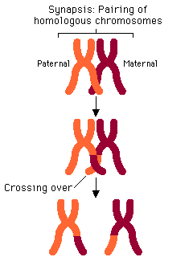
Crossing over results in Recombination of Alleles of different genes
B
B
b
b
A
a
a
A
b
B
b
B
A
a
a
A
B
B
b
b
A
a
A
a

Slide 30
What is Epistasis?
Epistasis is phenomenon where the effect of one gene (hypostatic) is modified by other gene (epistatic).
It is interaction between different genes (non alleles)
While, dominance is interaction between different alleles of the same gene

Slide 31
What is the dihydrid ratio?
9:3:3:1
Parental type
Parental type
Hybrid type

Slide 32
Modified Mendel Ratio in Wheat Kernel
For a trait contolled by two genes, these ratios will differ from the 9:3:3:1 that would be expected. These altered ratios are called modified Mendelian ratios.
Phenotypes: Kernel Color in Wheat
Parental Cross- AABB (coloured kernel) X aabb (colourless kernel)
F1 - coloured kernel (AaBb)
F2 - 15 Coloured kernel: 1 Colourless kernel

Slide 33
Punnett Square
Gametes | AB | Ab | aB | ab
AB | AABB (Colored) | AABb (Colored) | AaBB (Colored) | AaBb (Colored)
Ab | AABb (Colored) | Aabb (Colored) | AaBb (Colored) | Aabb (Colored)
aB | AaBB (Colored) | AaBb (Colored) | aaBB (Colored) | aaBb (Colored)
ab | AaBb (Colored) | Aabb (Colored) | aaBB (Colored) | aabb (Colorless)

Slide 34
Biochemical Explaination
Classic example of duplicate gene action
 | Gene A
 | Enzyme A
Precursor |  | Product (kernel colour)
 | Enzyme B
 | Gene B

Slide 35
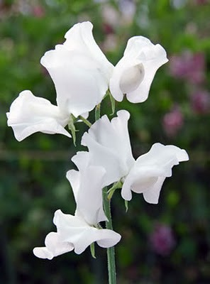
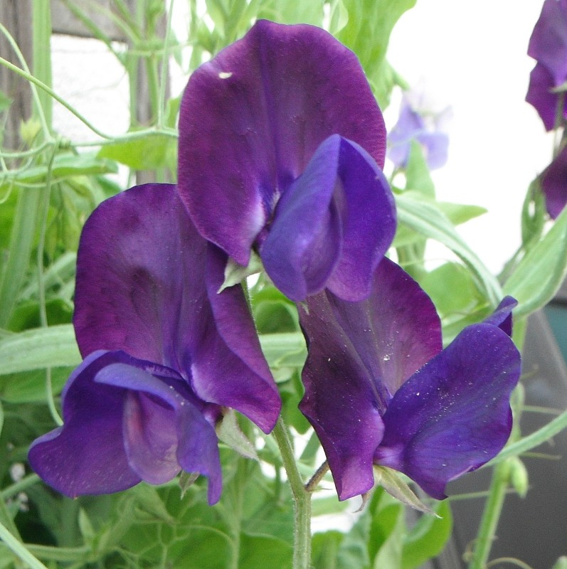
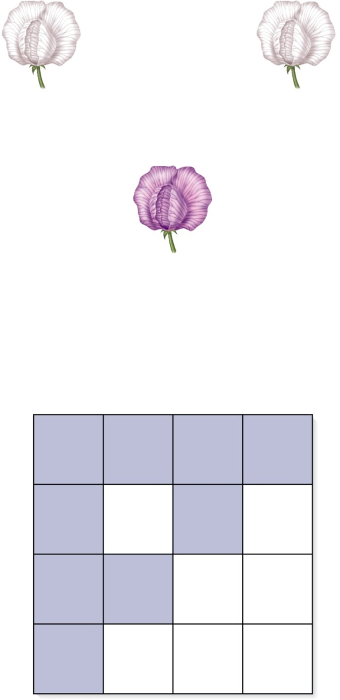
9:7 F2 ratio
x
White variety #1
(CCpp)
White variety #2
(ccPP )
F₁
All purple
(CcPp)
Self-fertilization
F₂
CP
Cp
cP
cp
CP
CCPP
Purple
CCPp
Purple
CcPP
Purple
CcPp
Purple
Cp
CCPp
Purple
CCpp
White
CcPp
Purple
Ccpp
White
cP
CcPP
Purple
CcPp
Purple
ccPP
White
ccPp
White
cp
CcPp
Purple
Ccpp
White
ccPp
White
ccpp
White

Slide 36
Possible biochemical mechanism?

Slide 37
Possible biochemical mechanism
Complementary Gene Action
Precursor (white)
Gene C Enzyme C
(Allele C) Intermediate (white)
Gene A Enzyme A
(Allele P)
Product (colored pigment)

Slide 38
Complementary gene action
A gene or genotype at one locus may produce a phenotype virtually identical to gene or genotype in another locus.
Enzyme C
Enzyme P
Precursor
Intermediate
Colored Product

Slide 39
Modified Mendel Ratio’s (9:7) (15:1) (13:3) (9:3:4)

Slide 40
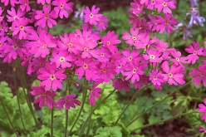
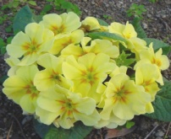
Modified Mendel Ratio in Primula
Phenotypes: Maldivin production in Primula
Parental Cross- Aabb (Maldivin producer) X aaBB(Maldivin non Producer)
F1 - Maldivin non Producer (AaBb)
F2 - 13 Maldivin non Producer : 3 Maldivin Producer

Slide 41
(Ratio: 13:3)
Gametes | AB | Ab | aB | ab
AB | AABB (Maldivin absent) | AABb (Maldivin absent) | AaBB (Maldivin absent) | AaBb (Maldivin absent)
Ab | AABb (Maldivin absent) | Aabb (Colored) | AaBb (Maldivin absent) | Aabb (Colored)
aB | AaBB (Maldivin absent) | AaBb (Maldivin absent) | aaBB (Maldivin absent) | aaBb (Maldivin absent)
ab | AaBb (Maldivin absent) | Aabb (Colored) | aaBB (Maldivin absent) | aabb (Maldivin absent)

Slide 42
How can you explain this?
It is a classic example of dominant suppression epistasis.
Dominant B allele masks the genes at the A locus
Genotype | Malvidin Production | Gene actions
9 A_B_ | No malvidin | no malvidin because dominant B allele is present
3 A_bb | Malvidin | malvidin productions because dominant A allele present
3 aaB_ | No malvidin | no malvidin because recessiveaand dominant B alleles present
1 aabb | No malvidin | no malvidin because recessive a allele present

Slide 43
Possible mechanism
B
Gene A
Enzyme A
X
(Precursor: White color)
Y
(Maldivin: colored Product)

Slide 44
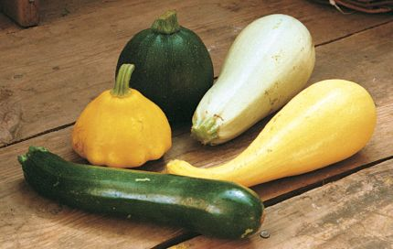
Dominant Epistasis
White (WWYY)
yellow (wwY_)
Green (wwyy)

Slide 45
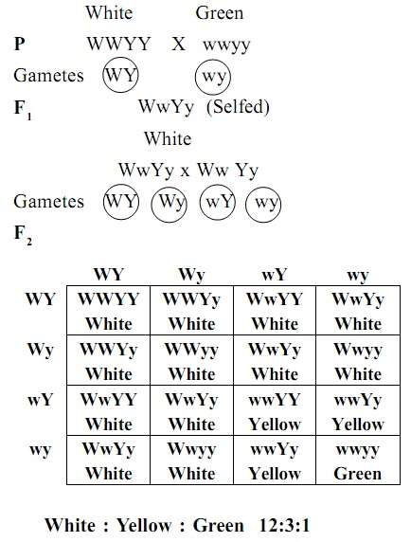
At the first gene locus white colored squash is dominant to colored squash, and the gene symbols are W=white and w=colored.
At the second gene yellow is dominant to green, and the symbols used are Y=yellow, y=green.

Slide 46
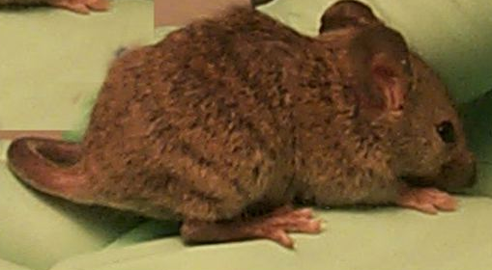
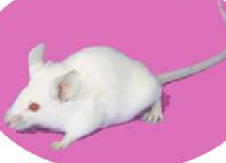
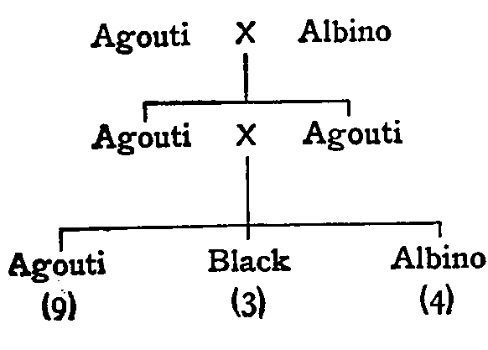
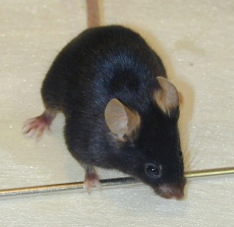
Modified Mendel Ratio in Coat color of mice
AACC
aacc
AaCc
AaCc
A_cc,
aacc
A_C_
aaC_

Slide 47
Gametes | AC | Ac | aC | ac
AC | AACC (Agouti) | AACc (Agouti) | AaCC (Agouti) | AaCc (Agouti)
Ac | AACc (Agouti) | AAcc (albino) | AaCc (Agouti) | Aacc (albino)
aC | AaCC (Agouti) | AaCc (Agouti) | aaCC (Black) | aaCc (Black)
ac | AaCc (Agouti) | Aacc (albino) | aaCC (Black) | aacc (albino)

Slide 48
Recessive Epistasis
In rodents, coat colour is determined by a pair of alleles at different genetic loci.
At one locus, the dominant allele C allows pigment formation ie. development of colour; the recessive allele c when homozygous prevents pigment formation regardless of the genotype of other coat colour genes.
Black mice are C/- ;
albinos are c/c.
At the other locus, the dominant allele A determines agouti pattern (ie. yellow
Banding of hairs) and the recessive allele a when homozygous produces non agouti
mice. Thus, A/- mice are agouti; a/a mice are non agouti.

Slide 49
Sex linked Inheritance
Alleles on sex chromosomes are inherited in predictable patterns. For example, in Drosophila the locus for eye color is located on the X chromosome. The allele for red eye color (RR), which is normal in wild flies, is dominant to the mutant allele for white eyes (rr).

Slide 50
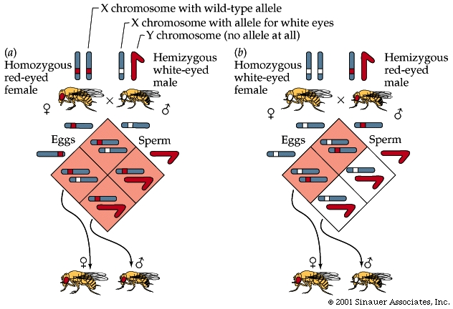
X linked Inheritance

Slide 51
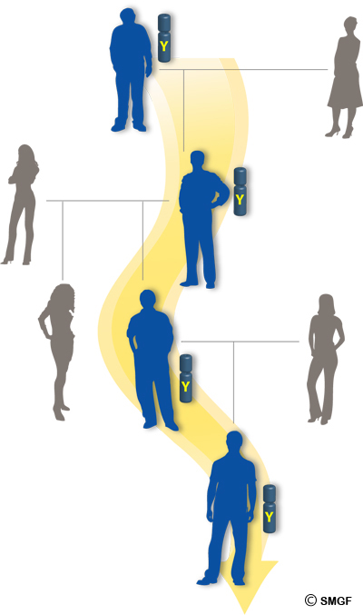
Y- linked inheritance
Y-linked inheritance: Inheritance of genes on the Y chromosome. Y-linked genes can only be transmitted from father to son.
Y-linked inheritance is also called holandric inheritance.
Ex. SRY (sex-determining region) for maleness.

Slide 52
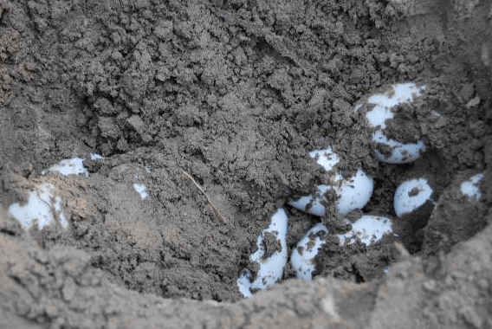
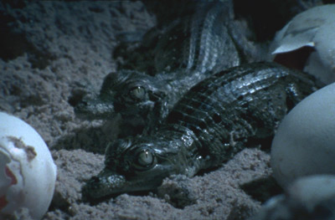
Temperature dependent sex determination
Alligators, crocodiles and turtles
Alligators & crocodiles: Incubation of eggs at 30ºC will results in female and temperature around 33ºC will results in males

Slide 53
ZW sex-determination system
Some birds, insects , reptiles etc
Males are the homogametic sex (ZZ), while females are the heterogametic sex (ZW).

Slide 54
Sex determination on Drosophila
The female determining genes are present on the X chromosome
But the male determining genes are present on the autosomes (2 sets autosomes)
Ratio of the number of X chromosomes and total set of autosomes determines the sex [ratio ≤ 0.5 results in males, ratio ≥1 results in females)
Genetic balance theory of sex determination

Slide 55
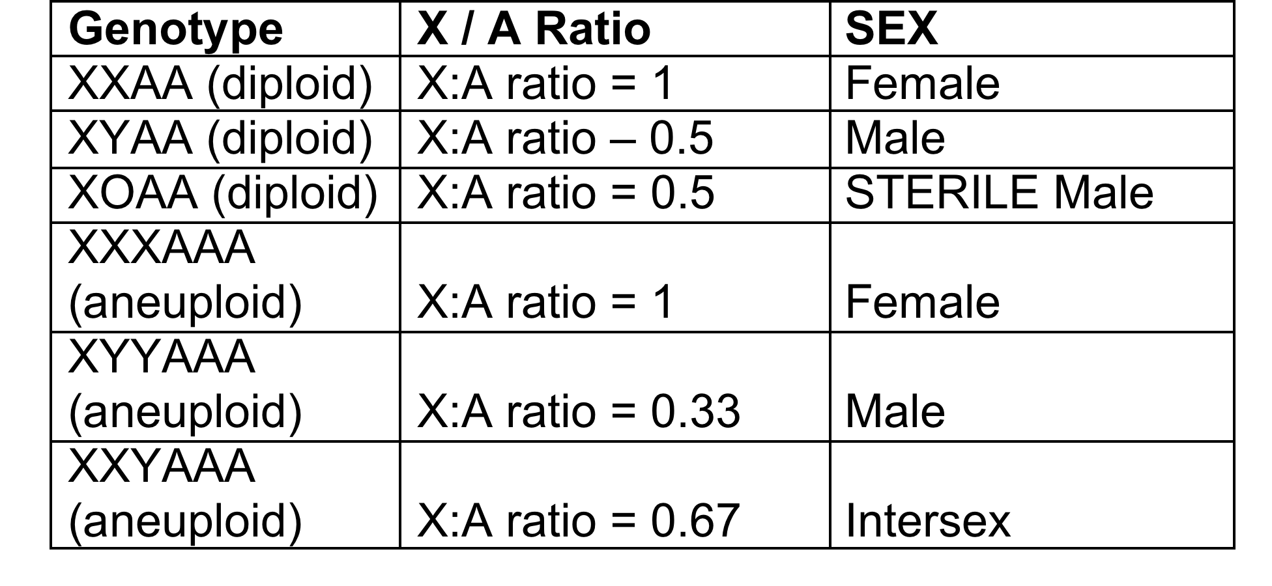
Sex Determination

Slide 56
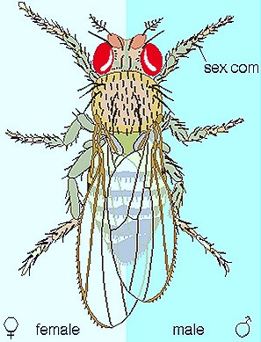
Gynandromorphs
An organism exhibiting both male and female characteristics
Abnormal behavior of the chromosome in insects

Slide 57
Pleiotropy
A gene that affects more than one trait.
Example:
In the human disease PKU (phenylketonuria). causes mental retardation and reduced hair and skin pigmentation

Slide 58
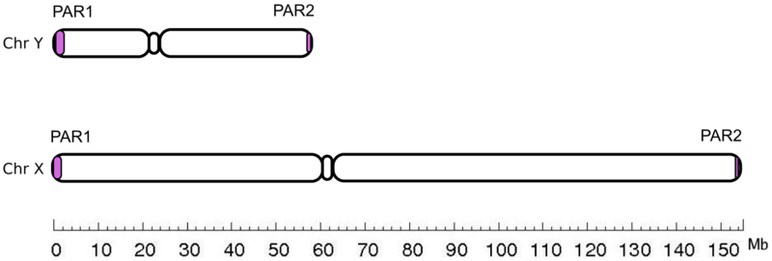
Similarity between X & Y chromosome
PseudoAutosomal Regions (PAR1, PAR2) are homologous sequences of nucleotides on the X and Y chromosome

Slide 59
Genetic terms commonly used to describe the type of alleles
Amorphic allele: A mutation that causes complete loss of gene function. Amorph is sometimes used interchangeably with "genetic null".
Hypomorph allele : A mutation that causes a partial loss of gene function
Hypermorph allele: A mutation that causes an increase in normal gene function. Hypermorphic alleles are dominant gain of function alleles.
Antimorph allele: A dominant mutation that acts in opposition to normal gene activity. Antimorphs are also called dominant negative mutations
Neomorphic allele: A mutation that causes dominant gain of gene function that is different from the normal function

Slide 60
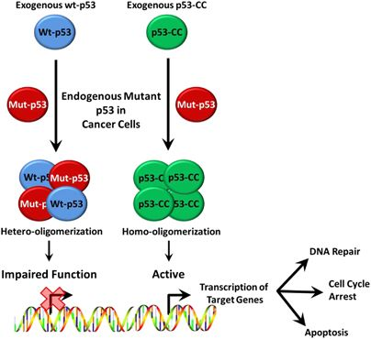
Dominant negative mutation
WT-p53

Slide 61
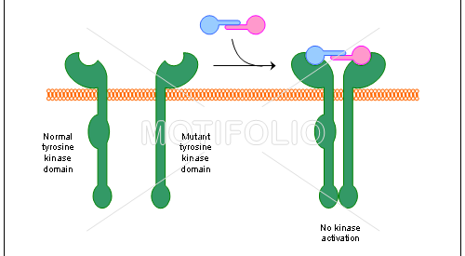
Dominant negative (Example)

Slide 62
17 MS batch – Room No 107
18MS002- 18MS113- Room 107
18MS114- 18MS146- ROOM NO 110
18MS 147- 18MS215- ROOM NO G06

Slide 63
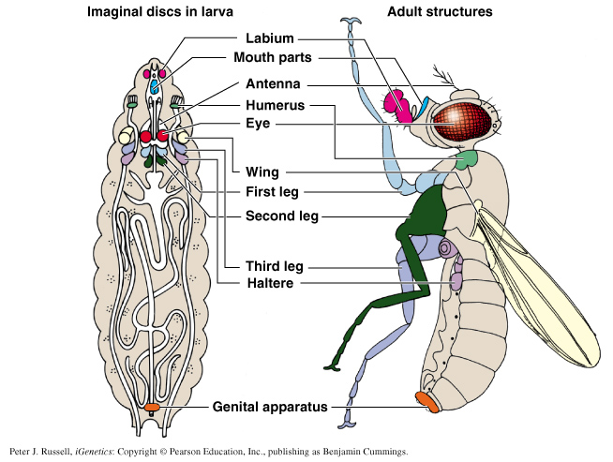
Fig. 19.21, Locations of homologous imaginal discs in larva and adult.

Slide 64
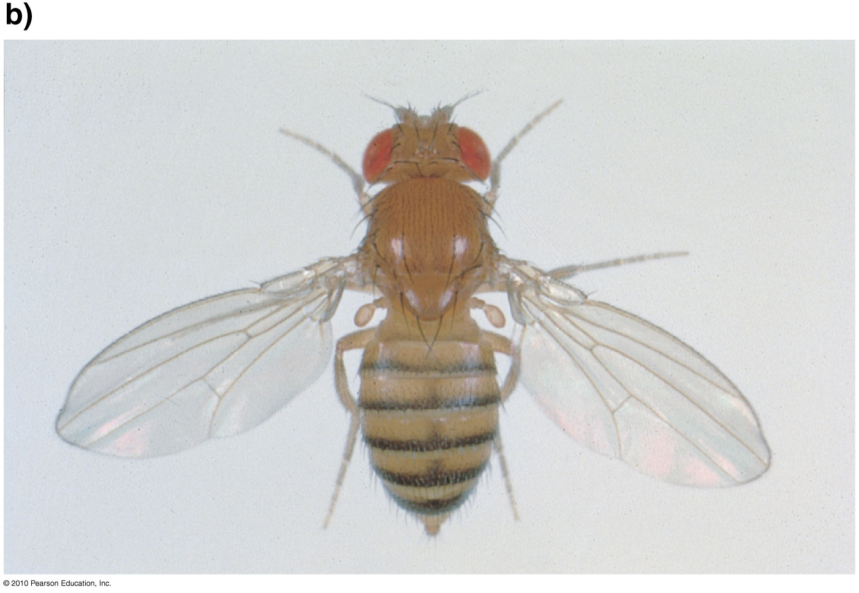
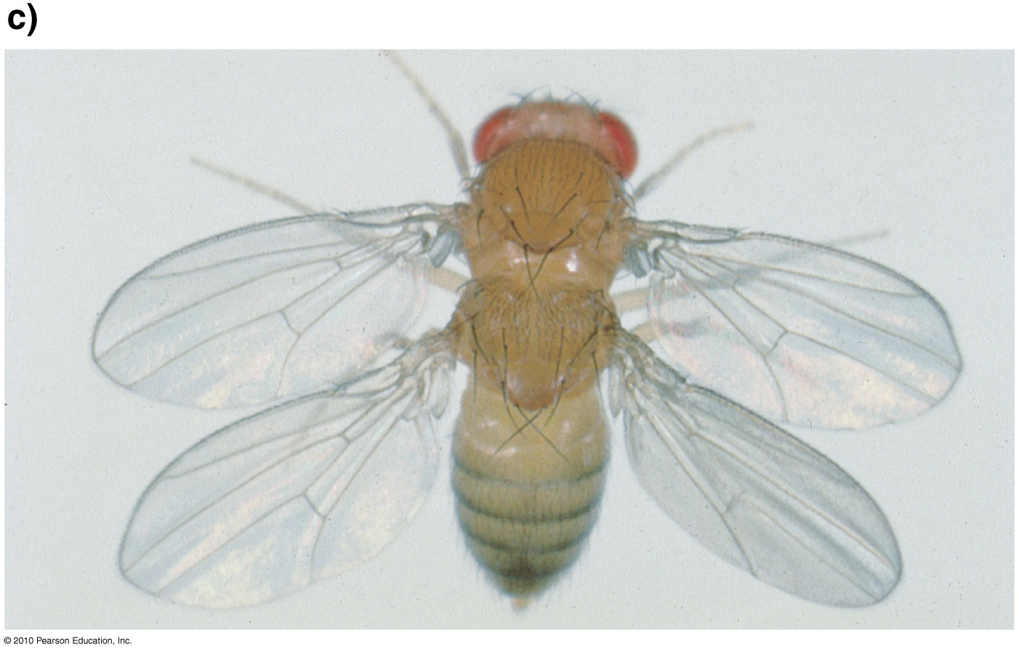
Fig. 19.26
Examples of homeotic Drosophila mutant with the bithorax mutation
What is wrong with one of
these flies?

Slide 65
Chi-Square Test

Slide 66
A fundamental issue in genetics is how to determine whether the experimental data fits the theoretical expected results?

Slide 67
For a monohybrid cross:
F2 ratio- 3:1
For a Dihybrid cross:
F2 ration- 9:3:3:1

Slide 68
Goodness of Fit
The chi-square test is a “goodness of fit” test: it answers the question of how well do experimental data fit expectations.
One starts with a theory for how the offspring will be distributed:
“Null hypothesis”. The difference is observed by chance i.e.
Offspring will appear in an expected ratio like 3:1 or 9:3:3:1 etc

Slide 69
Formula
Determine the number of each phenotype that have been observed and how many would be expected given basic genetic theory.
Then calculate the chi-square statistic using this formula.
.

Slide 70
Example
As an example, for a monohybrid cross in F2 offsprings one gets 290 purple and 110 white flowers. Is the observed numbers significant for 3:1 ratio?
Theoretical Expectation: 3/4 : 1/4 ratio.
Expected purple 400 * 3/4 = 300 purple,
Expected White 400 * 1/4 = 100 white.
Observed purple = 290 Observed white, = 110
Applying the numbers in chi-square analysis:
Χ² = (290 - 300)² / 300 + (110 - 100)² / 100
= (-10)² / 300 + (10)² / 100
= 100 / 300 + 100 / 100
= 0.333 + 1.000
= 1.333.
This is our chi-square value: now we need to see what it means and how to use it.

Slide 71
If the results were perfect you get a chi-square value of 0 (because obs = exp).
If you get a high chi-square value: a result from the wrong theory.
Low chi-square value needs to be checked for evaluating the hypothesis.

Slide 72
What is a “reasonable” result?
A result is said to not differ significantly from expectations if deviation is observed once in 20 trials.
“1 time in 20” can be written as a probability value p = 0.05,meaning that in case of true null hypothesis, there is chance of getting this deviation once in 20 trials.
.

Slide 73
How do you calculate the p value from chi square?
One uses the chi square table

Slide 74
Degrees of Freedom
A critical factor in using the chi-square test is the “degrees of freedom”, which is essentially the number of independent random variables involved.
Degrees of freedom is simply the number of classes of offspring minus 1.
For our example, there are 2 classes of offspring: purple and white. Thus, degrees of freedom (d.f.) = 2 -1 = 1.

Slide 75
Critical Chi-Square
Critical values for chi-square are found on tables, sorted by degrees of freedom and probability levels. Be sure to use p = 0.05.
If your calculated chi-square value is greater than the critical value from the table, you “reject the null hypothesis”.
If your chi-square value is less than the critical value, you “fail to reject” the null hypothesis (that is, you accept that your genetic theory about the expected ratio is correct).

Slide 76
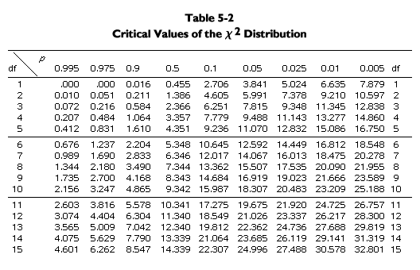
Chi-Square Table
Difference between the observed
and the expected is significant and it can’t be by chance alone.

Slide 77
Using the Table
In the example of 290 purple to 110 white, we calculated a chi-square value of 1.333, with 1 degree of freedom.
Looking at the table, 1 d.f. is the first row, and p = 0.05 is the sixth column. Here we find the critical chi-square value, 3.841.
Since the calculated chi-square, 1.333, is less than the critical value, 3.841, one “fails to reject” the null hypothesis. Thus, an observed ratio of 290 purple to 110 white is a good fit to a 3/4 to 1/4 ratio.

Slide 78
Another Example: from Mendel
phenotype | observed | expected proportion
round yellow | 315 | 9/16
round green | 101 | 3/16
wrinkled yellow | 108 | 3/16
wrinkled green | 32 | 1/16
total | 556

Slide 79
Chi-Square Table

Slide 80
Another Example: from Mendel
phenotype | observed | expected proportion | expected number
round yellow | 315 | 9/16 | 312.75
round green | 101 | 3/16 | 104.25
wrinkled yellow | 108 | 3/16 | 104.25
wrinkled green | 32 | 1/16 | 34.75
total | 556 |  | 556

Slide 81
Calculating the Chi-Square Value
Use the formula.
X² = (315 - 312.75)2 / 312.75
+ (101 - 104.25)2 / 104.25
+ (108 - 104.25)2 / 104.25
+ (32 - 34.75)2 / 34.75
= 0.016 + 0.101 + 0.135 + 0.218
= 0.470.

Slide 82
Finding the Expected Numbers
The total number of offsprings observed.
In this case, 315 + 101 + 108 + 32 = 556.
Then multiply total offspring by the expected proportion:
--expected round yellow = 9/16 * 556 = 312.75
--expected round green = 3/16 * 556 = 104.25
--expected wrinkled yellow = 3/16 * 556 = 104.25
--expected wrinkled green = 1/16 * 556 = 34.75

Slide 83
D.F. and Critical Value
Degrees of freedom is 1 less than the number of classes of offspring. Here, 4 - 1 = 3 d.f.
For 3 d.f. and p = 0.05, the critical chi-square value is 7.815.
Since the observed chi-square (0.470) is less than the critical value, we fail to reject the null hypothesis. We accept Mendel’s conclusion that the observed results for a 9/16 : 3/16 : 3/16 : 1/16 ratio.

Slide 84
Let’s See how sample size affects the Chi square statistic

Slide 85
Calculate Chi square statistic for two arbitrary sample at 1:1 ratio
Sample 1: Observed-15:35,
Expected- 15+35/2= 25
Sample 2: Observed 240:260, Expected = 500/2=250
X²= (15- 25)² + (35- 25)² = 200/25 = 8
25 25
X²= (240- 250)² + (260- 250)² = 200/250 = 0.8
250 250

Slide 86
Chi-Square Table

Slide 87
Question!
In the F2 generation of a certain tomato experiment 3629 fruits were red, while 1175 were yellow. A 3:1 ratio was expected. Are the discrepancies between observed and expected significant?

